Slide 1
Object Oriented Programming
Java Special
Lec: 05

Slide 2
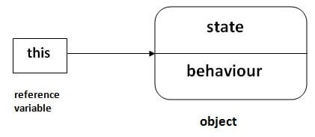
this keyword in Java
There can be a lot of usage of Java this keyword. In Java, this is a reference variable that refers to the current object.

Slide 3
Without this keyword
class Student{
int rollno;
String name;
float fee;
Student(int rollno,String name,float fee){
rollno=rollno;
name=name;
fee=fee;
}
void display(){System.out.println(rollno+" "+name+" "+fee);}
}
class TestThis1{
public static void main(String args[]){
Student s1=new Student(111,"ali",5000f);
Student s2=new Student(112,"sana",6000f);
s1.display();
s2.display();
}}
0 null 0.0
0 null 0.0

Slide 4
With this keyword
class TestThis2{
public static void main(String args[]){
Student s1=new Student(111,"ali",5000f);
Student s2=new Student(112,"saba",6000f);
s1.display();
s2.display();
}}
class Student{
int rollno;
String name;
float fee;
Student(int rollno,String name,float fee){
this.rollno=rollno;
this.name=name;
this.fee=fee;
}
void display(){System.out.println(rollno+" "+name+" "+fee);}
}
111 ali 5000.0
112 saba 6000.0

Slide 5
Final Keyword In Java
The final keyword in java is used to restrict the user. The java final keyword can be used in many context. Final can be:
variable
method
class
The final keyword can be applied with the variables, a final variable that have no value it is called blank final variable or uninitialized final variable. It can be initialized in the constructor only. The blank final variable can be static also which will be initialized in the static block only. We will have detailed learning of these. Let's first learn the basics of final keyword.

Slide 6
Java final variable
Output:Compile Time Error
If you make any variable as final, you cannot change the value of final variable(It will be constant).
class Bike9{
final int speedlimit=90;//final variable
void run(){
speedlimit=400;
}
public static void main(String args[]){
Bike9 obj=new Bike9();
obj.run();
}
}
Output:Compile Time Error

Slide 7
Java final method
If you make any method as final, you cannot override it.
class Bike{
final void run(){System.out.println("running");}
}
class Honda extends Bike{
void run(){System.out.println("running safely with 100kmph");}
public static void main(String args[]){
Honda honda= new Honda();
honda.run();
}
}

Slide 8
Java final class
If you make any class as final, you cannot extend it.
final class Bike{}
class Honda1 extends Bike{
void run(){System.out.println("running safely with 100kmph");}
public static void main(String args[]){
Honda1 honda= new Honda1();
honda.run();
}
}

Slide 9
Access Modifiers in Java
The access modifiers in Java specifies the accessibility or scope of a field, method, constructor, or class. We can change the access level of fields, constructors, methods, and class by applying the access modifier on it.
There are four types of Java access modifiers:
Private: The access level of a private modifier is only within the class. It cannot be accessed from outside the class.
Protected: The access level of a protected modifier is within the package and outside the package through child class. If you do not make the child class, it cannot be accessed from outside the package.
Public: The access level of a public modifier is everywhere. It can be accessed from within the class, outside the class, within the package and outside the package.

Slide 10
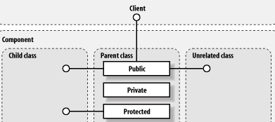

Slide 11
Abstract class
A class which is declared with the abstract keyword is known as an abstract class in Java. It can have abstract and non-abstract methods (method with the body).
Abstraction is a process of hiding the implementation details and showing only functionality to the user.
There are two ways to achieve abstraction in java
Abstract class
Interface

Slide 12
Abstract class
An abstract class must be declared with an abstract keyword.
It can have abstract and non-abstract methods.
It cannot be instantiated.
It can have constructors and static methods also.
It can have final methods which will force the subclass not to change the body of the method.
abstract class A{}

Slide 13
Abstract Method in Java
A method which is declared as abstract and does not have implementation is known as an abstract method.
abstract void printStatus();//no method body and abstract

Slide 14
Example of Abstract class that has an abstract method
running safely
abstract class Bike{
abstract void run();
}
class Honda4 extends Bike{
void run(){System.out.println("running safely");}
public static void main(String args[]){
Bike obj = new Honda4();
obj.run();
}
}
running safely

Slide 15
Abstract class
abstract class Shape{
abstract void draw();
}
class Rectangle extends Shape{
void draw(){System.out.println("drawing rectangle");}
}
class Circle1 extends Shape{
void draw(){System.out.println("drawing circle");}
}
class TestAbstraction1{
public static void main(String args[])
{
Shape s=new Circle1();
s.draw();
}
}

